Slide 1

Delay Prediction in Supply Chains: A Hybrid Graph-Based and Machine Learning Approach
Candidate: Volpato Mattia
Supervisor: Prof. Michele Ciavotta
Company Co-Supervisor: Eng. Bruno Puzzolante
Master degree
Computer Science

Slide 2
Agenda
M4ESTRO Project Overview
Background & Context
Motivation & Purpose Key Contributions
Dataset & External Sources
Pilot and Tracking data
Traffic, Weather and Holiday data
Supply Chain Modeling
Supply Chain Graph Model
Markov Chain Routing Model
Paths Extraction and Probability Distributions
Historical Indicators
Definition
Implementation
Realtime Indicators
Overview
Definition
Implementation
Protoype & Results
Prototype Architecture
Evaluation Methodology
Quantitative Evaluation
Sensitivity Analysis
Evolution of Shipment Estimates
Conclusion
Key Findings
Future Developments

Slide 3
M4ESTRO Project Overview

Slide 4

Background & Context
M4ESTRO Project OVERVIEW
Disruptions are reshaping the manufacturing industry, revealing global supply chain vulnerabilities and highlighting the critical need for resilience.
Supply Chain Challenges
Global disruptions (pandemics, conflicts, climate events) expose supply chain fragility.
Rising disruption frequency and severity create volatile, uncertain, complex, and ambiguous (VUCA) conditions.
Resilience and adaptability are essential for continuity and competitiveness.

Slide 5



M4ESTRO – A Horizon Europe Project
M4ESTRO Project OVERVIEW
Project Goals
Consortium and Scope
Strategic Pillars
Develop a resilient, transparent, and adaptive ecosystem under the Manufacturing-as-a-Service (MaaS) paradigm, enhancing supply chain flexibility and robustness.
Consortium of 18 partners from 8 countries, including industrial pilots, technology providers, and research institutions, collaborating over 42 months.
Four pillars support M4ESTRO: resilient manufacturing processes, AI-enabled adaptive equipment, industrial metaverse simulations and human-centered sustainability and resilience.

Slide 6
Research Motivation & Purpose
M4ESTRO Project OVERVIEW
M4ESTRO - Industrial Manufacturing As a sErvice STRategies and models for flexible, resilient, and re-configurable value networks through Trusted and Transparent Operations
1. Motivation
2. Purpose
Global disruptions (pandemics, conflicts, climate events) expose supply chain fragility.
Rising disruption frequency and severity create volatile, uncertain, complex, and ambiguous (VUCA) conditions.
Resilience and adaptability are essential for continuity and competitiveness.
M4ESTRO introduces the concept of disruption indicator:
Monitor the operational dynamics of the supply chain.
Detect anomalies in real time across logistics systems.
Quantify the impact of disruptions using interpretable data-driven metrics.
Enable timely responses through integration with decision-support tools.

Slide 7
Key Contributions
This work addresses Task 1.2, focusing on the design of Logistics Chain Disruption Indicators (LCDIs) for detecting internal disruptions.
It concentrates on a subset of LCDIs aimed at estimating delivery times and delays within a single-manufacturer supply chain.
M4ESTRO Project OVERVIEW
Supply chain modeling
Mathematical framework for modeling a single-manufacturer supply chain.
Indicators Design and Implementation
Logistics Chain Disruption Indicators (LCDIs) to quantify:
Dispatch and shipment process durations.
Real-time traffic and weather impacts on shipments.
Effect of national holidays on dispatch processes.
Prototype development and deployment
Prototype using pilot partner data deployed on AWS cloud infrastructure.

Slide 8
Dataset & External Sources

Slide 9



Pilot and Tracking Data
Dataset & EXTERNAL SOURCES
Pilot Order Data
Carrier Tracking Data
Geographical Data
FAE Technology, core dataset provider: one-hundred order records with supplier locations, timestamps and tracking links.
17Track API to retrieve shipment events across multiple carriers, including location, timestamp, and status.
Geonames API to standardize shipment events and supplier locations at a city level.
Three sources forming the core dataset, providing the foundational data that captures the supply chain structure.

Slide 10





Traffic, Weather and Holiday Data
Dataset & EXTERNAL SOURCES
Traffic Data
Weather Data
Holiday Data
TomTom API to retrieve road traffic data, comparing ideal vs real-time conditions between two locations.
Visual Crossing API to retrieve weather data, providing real-time conditions for any location.
Calendarific API to retrieve national holidays worldwide, providing indications on supplier closures.
Three complementary sources enrich the core dataset, providing a complete representation of the supply chain.

Slide 11
Supply Chain Modeling

Slide 12
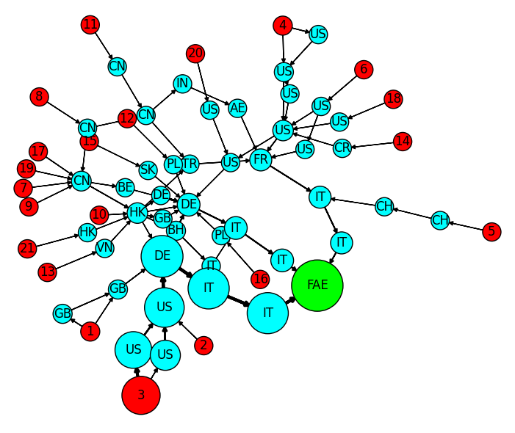
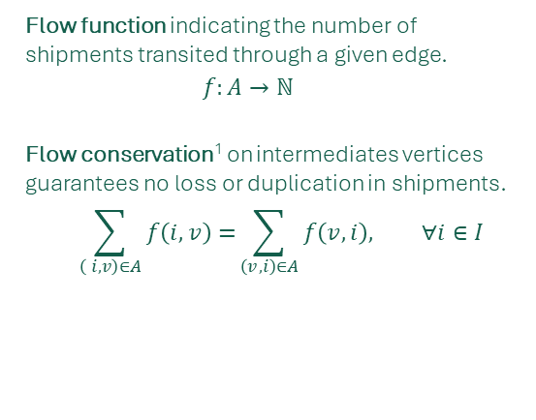
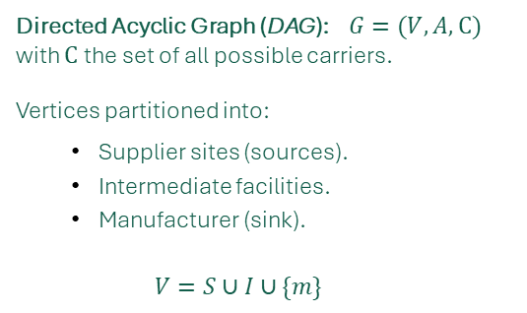
Supply Chain Graph Model
Supply CHAIN Modeling
Graph Structure
Directed Acyclic Graph (DAG): $G=(V, A,C)$ with $C$ the set of all possible carriers.
Vertices partitioned into:
Supplier sites (sources).
Intermediate facilities.
Manufacturer (sink).
$$V=S∪I∪\{m\}$$
Shipments Flow
Flow function indicating the number of shipments transited through a given edge.
$$f:A→ℕ$$
Flow conservation¹ on intermediates vertices guarantees no loss or duplication in shipments.
$$\sum_{\left( i, v\right)∈A}{f\left(i,v\right)=}\sum_{\left(v, i\right)∈A}{f\left(v,i\right), ∀i∈I}$$
Supplier sites
Intermediate locations
Manufacturer
1. L. R. Ford and D. R. Fulkerson, “Maximal flow through a network”

Slide 13
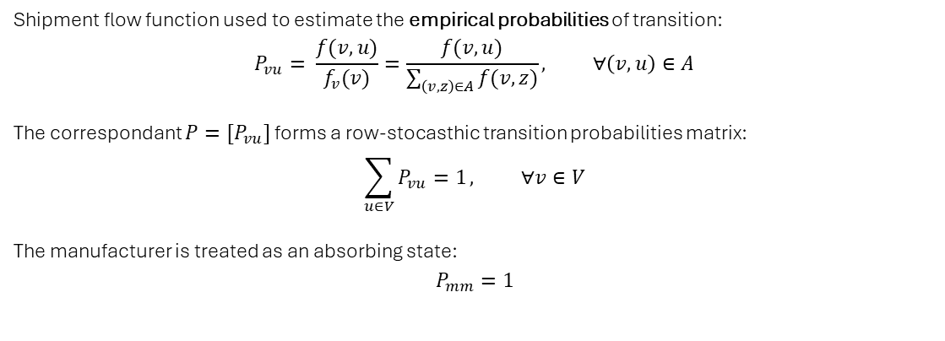
Markov Chain Routing Model (1)
Supply CHAIN Modeling
Empirical Probabilities
Shipment flow function used to estimate the empirical probabilities of transition:
$$P_{vu}= \frac{f(v,u)}{f_{v}(v)}=\frac{f(v,u)}{\sum_{\left(v,z\right)∈A}{f(v,z)}}, ∀\left(v,u\right)∈A$$
The correspondant ${P=[P}_{vu}]$ forms a row-stocasthic transition probabilities matrix:
$$\sum_{u∈V}{P_{vu}=1}, ∀v∈V$$
The manufacturer is treated as an absorbing state:
$$P_{mm}=1$$
Shipments are represented as maximal paths ending in the manufacturer. The routing process is modeled using discrete-time Markov chains, capturing shipment trajectories as stochastic processes based on empirical transition probabilities derived from historical shipment flows.

Slide 14
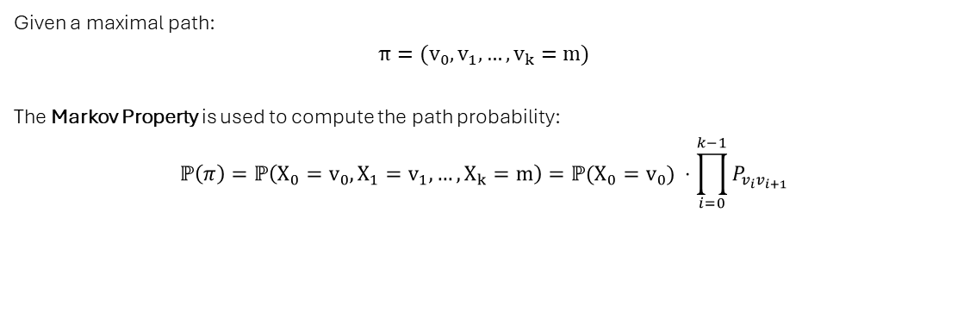
Markov Chain Routing Model (2)
Supply CHAIN Modeling
Probabilistic Routing
Given a maximal path:
$$π={(v}_{0},v_{1}, …,v_{k}=m)$$
The Markov Property is used to compute the path probability:
$$ℙ\left(π\right)=ℙ\left(X_{0}=v_{0},X_{1}=v_{1}, …,X_{k}=m\right)=ℙ(X_{0}=v_{0}) ⋅\prod_{i=0}^{k−1}{P_{v_{i}v_{i+1}}}$$
Shipments are represented as maximal paths ending in the manufacturer. The routing process is modeled using discrete-time Markov chains, capturing shipment trajectories as stochastic processes based on empirical transition probabilities derived from historical shipment flows.

Slide 15
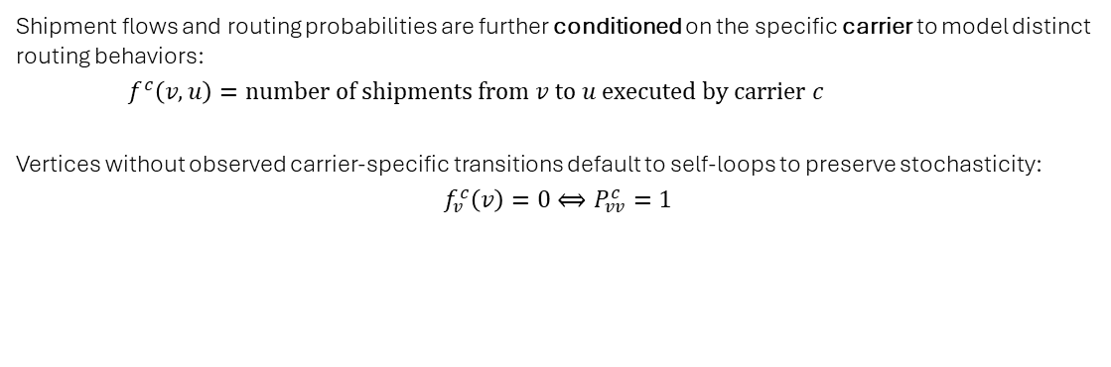
Markov Chain Routing Model (3)
Supply CHAIN Modeling
Carrier-Conditioned Dynamics
Shipment flows and routing probabilities are further conditioned on the specific carrier to model distinct routing behaviors:
$f^{c}\left(v,u\right)=number of shipments from v to u executed by carrier c$
Vertices without observed carrier-specific transitions default to self-loops to preserve stochasticity:
$$f_{v}^{c}\left(v\right)=0⟺P_{vv}^{c}=1$$
Shipments are represented as maximal paths ending in the manufacturer. The routing process is modeled using discrete-time Markov chains, capturing shipment trajectories as stochastic processes based on empirical transition probabilities derived from historical shipment flows.

Slide 16
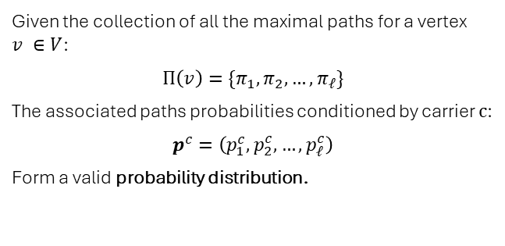
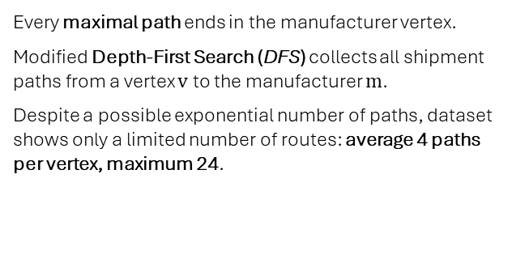
Paths Extraction and Probability Distributions
Supply CHAIN Modeling
1. Paths Extraction Methodology
2. Probability Distribution Computation
Every maximal path ends in the manufacturer vertex.
Modified Depth-First Search (DFS) collects all shipment paths from a vertex $v$ to the manufacturer $m$.
Despite a possible exponential number of paths, dataset shows only a limited number of routes: average 4 paths per vertex, maximum 24.
Given the collection of all the maximal paths for a vertex $v ∈V$:
$$Π\left(v\right)=\{π_{1},π_{2},…,π_{ℓ}\}$$
The associated paths probabilities conditioned by carrier $c$:
$$p^{c}=\left(p_{1}^{c},p_{2}^{c},…,p_{ℓ}^{c}\right)$$
Form a valid probability distribution.
For each vertex, carrier behavior is modeled by considering all possible paths to the manufacturer, along with the probability that each path is followed.

Slide 17
Historical Indicators

Slide 18
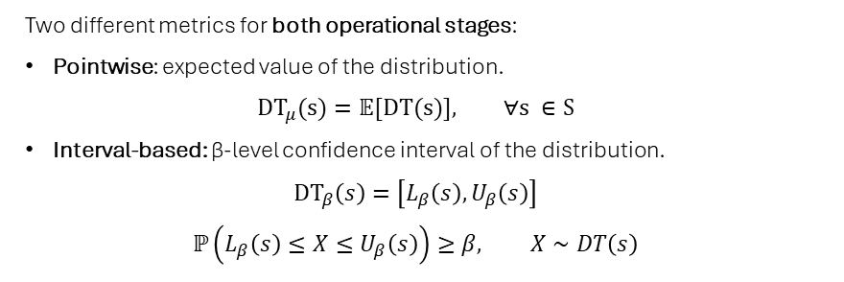
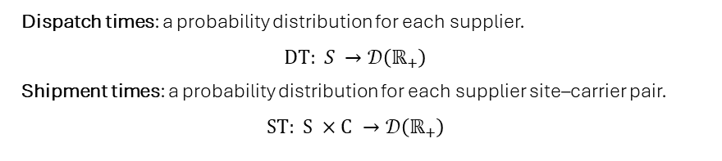
Historical Indicators Definition
HISTORICAL Indicators
Time Probability Distributions
Dispatch process: from order placement to shipment start.
Shipment process: from shipment start to delivery.
Delivery process: combination of dispatch and shipment processes.
Dispatch times: a probability distribution for each supplier.
$$DT: S →𝒟\left(ℝ_{+}\right)$$
Shipment times: a probability distribution for each supplier site–carrier pair.
$$ST: S ×C →𝒟\left(ℝ_{+}\right)$$
Historical indicators are stastistical measures that characterize key operational times in the order fulfillment process, based exclusively on historical data.
Statistical Metrics
Two different metrics for both operational stages:
Pointwise: expected value of the distribution.
$$DT_{μ}(s)=𝔼[DT(s)], ∀s ∈S$$
Interval-based: β-level confidence interval of the distribution.
$$DT_{β}\left(s\right)=\left[L_{β}\left(s\right),U_{β}\left(s\right)\right]$$
$$ℙ\left(L_{β}\left(s\right)≤X≤U_{β}\left(s\right)\right)≥β, X∼DT\left(s\right)$$

Slide 19
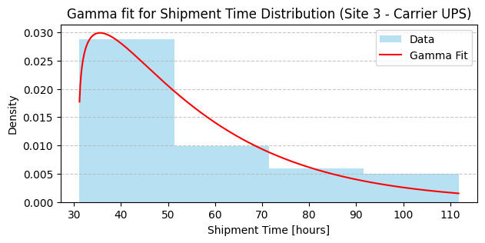
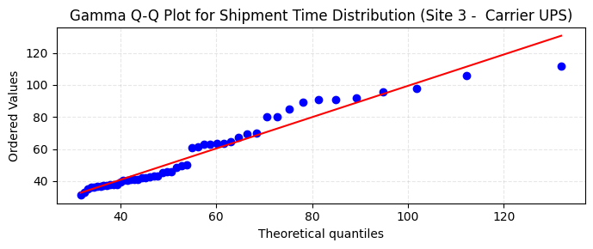
Historical Indicators Implementation
HISTORICAL INDICATORS
Theoretical Distribution
Fitting Procedure
Gamma distributions chosen for their established use in supply-chain literature.
Parameter estimation via Maximum Likelihood Estimation.
Data threshold: Samples with ≥30 observations.
Outlier removal: Interquartile Range (IQR) method. Goodness-of-fit checks: Q–Q plots and histograms. Statistical validation: Bootstrap Kolmogorov–Smirnov tests show no evidence against the Gamma assumption.

Slide 20
Realtime Indicators

Slide 21
Realtime Indicators Overview
Realtime indicators are statistical measures that provide actionable insights into the current state of the supply chain.
Organized hierarchically at different granularity levels, they combine:
Historical indicators.
Supply chain graph.
Real-time data.
Realtime indicators from lower levels.
Realtime Indicators
Realtime Indicators Hierarchy
Granularity | Scope
Vertex | Supplier and carrier facility.
Route | Carrier route between two locations.
Path | Supplier to manufacturer carrier path.
Graph | Overall supply chain network.

Slide 22
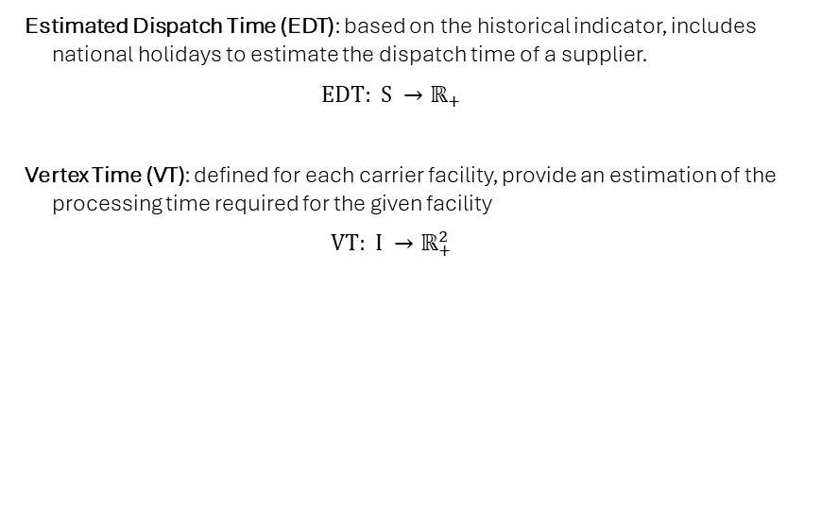
Realtime Indicators Definition (1)
Realtime indicators are statistical measures that provide actionable insights into the current state of the supply chain.
Organized hierarchically at different granularity levels, they combine:
Historical indicators.
Supply chain graph.
Real-time data.
Realtime indicators from lower levels.
Realtime Indicators
Vertex Level
Estimated Dispatch Time (EDT): based on the historical indicator, includes national holidays to estimate the dispatch time of a supplier.
$$EDT: S →ℝ_{+}$$
Vertex Time (VT): defined for each carrier facility, provide an estimation of the processing time required for the given facility
$$VT: I →ℝ_{+}^{2}$$

Slide 23
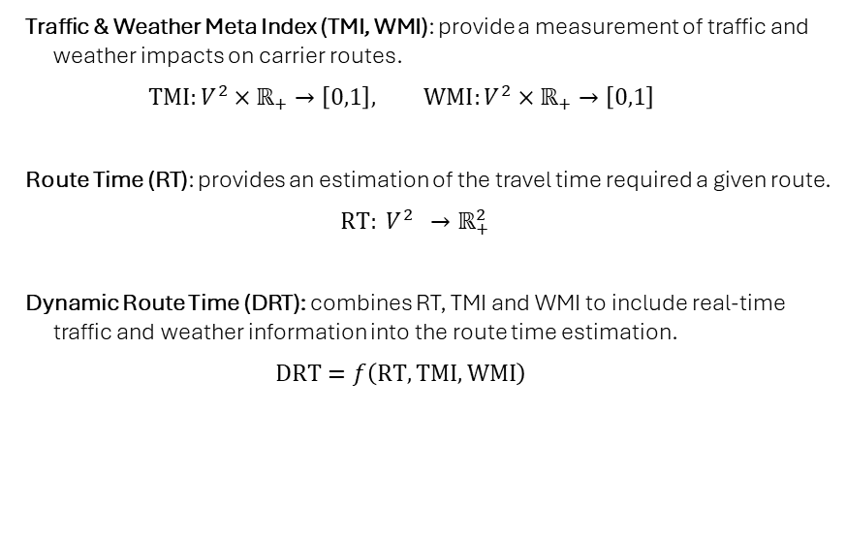
Realtime Indicators Definition (2)
Realtime indicators are statistical measures that provide actionable insights into the current state of the supply chain.
Organized hierarchically at different granularity levels, they combine:
Historical indicators.
Supply chain graph.
Real-time data.
Realtime indicators from lower levels.
Realtime Indicators
Route Level
Traffic & Weather Meta Index (TMI, WMI): provide a measurement of traffic and weather impacts on carrier routes.
$$TMI:V^{2}×ℝ_{+}→\left[0,1\right], WMI:V^{2}×ℝ_{+}→\left[0,1\right]$$
Route Time (RT): provides an estimation of the travel time required a given route.
$$RT: V^{2} →ℝ_{+}^{2}$$
Dynamic Route Time (DRT): combines RT, TMI and WMI to include real-time traffic and weather information into the route time estimation.
$$DRT=f\left(RT,TMI,WMI\right)$$

Slide 24
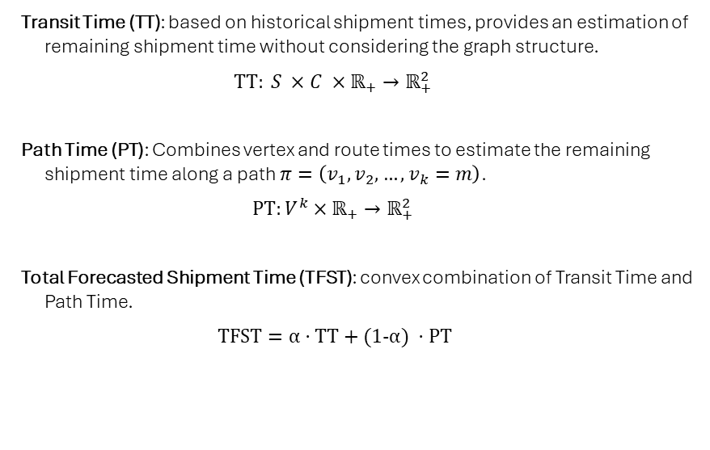
Realtime Indicators Definition (3)
Realtime indicators are statistical measures that provide actionable insights into the current state of the supply chain.
Organized hierarchically at different granularity levels, they combine:
Historical indicators.
Supply chain graph.
Real-time data.
Realtime indicators from lower levels.
Realtime Indicators
Path Level
Transit Time (TT): based on historical shipment times, provides an estimation of remaining shipment time without considering the graph structure.
$$TT: S ×C ×ℝ_{+}→ℝ_{+}^{2}$$
Path Time (PT): Combines vertex and route times to estimate the remaining shipment time along a path $π=\left(v_{1},v_{2},…,v_{k}=m\right)$.
$$PT:V^{k}×ℝ_{+}→ℝ_{+}^{2}$$
Total Forecasted Shipment Time (TFST): convex combination of Transit Time and Path Time.
$$TFST=α⋅TT+(1−α) ⋅PT$$

Slide 25
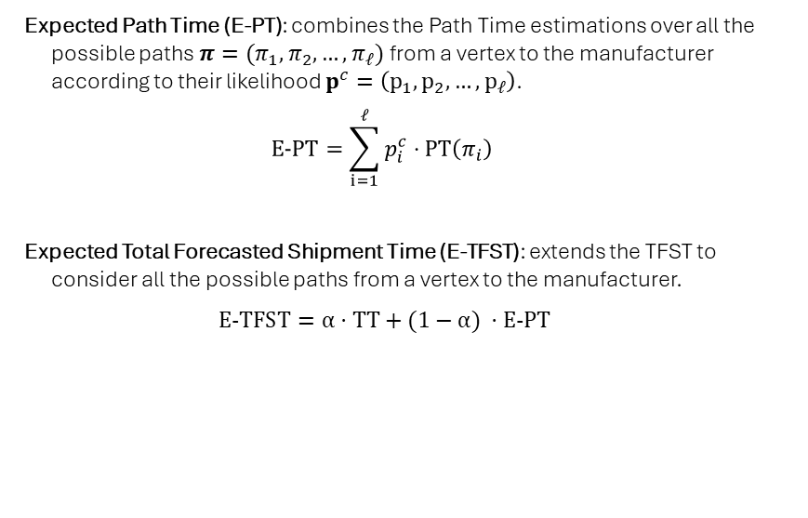
Realtime Indicators Definition (4)
Realtime indicators are statistical measures that provide actionable insights into the current state of the supply chain.
Organized hierarchically at different granularity levels, they combine:
Historical indicators.
Supply chain graph.
Real-time data.
Realtime indicators from lower levels.
Realtime Indicators
Graph Level
Expected Path Time (E-PT): combines the Path Time estimations over all the possible paths $π=(π_{1},π_{2},…,π_{ℓ})$ from a vertex to the manufacturer according to their likelihood $p^{c}=\left(p_{1},p_{2},…,p_{ℓ}\right)$.
$$E−PT=\sum_{i=1}^{ℓ}{p_{i}^{c}⋅PT\left(π_{i}\right)}$$
Expected Total Forecasted Shipment Time (E-TFST): extends the TFST to consider all the possible paths from a vertex to the manufacturer.
$$E−TFST=α⋅TT+(1−α) ⋅E−PT$$

Slide 26
Realtime Indicators Implementation
REALTIME INDICATORS
Theoretical Distribution
Fitting Procedure
Gamma distributions chosen for their established use in supply-chain literature.
Parameter estimation via Maximum Likelihood Estimation.
Data threshold: Samples with ≥30 observations.
Outlier removal: Interquartile Range (IQR) method. Goodness-of-fit checks: Q–Q plots and histograms. Statistical validation: Bootstrap Kolmogorov–Smirnov tests show no evidence against the Gamma assumption.

Slide 27
Realtime Indicators Overview
REALTIME INDICATORS
1
2
3
Dispatch Stage Indicators
Shipment and Route Indicators
Path and Delivery Level Indicators
Estimated Dispatch Time (EDT) quantifies expected supplier dispatch duration using historical distributions and adjusts for real-time factors like holidays and reported delays. Inclusion of supplier holiday calendars refines dispatch time estimates, accounting for non-operational periods that impact readiness and scheduling. Dispatch stage indicators provide early warnings before shipments commence, crucial for proactive disruption management.
Overall Residence Index (ORI) models processing times at intermediate facilities, aggregating durations across carriers to assess bottlenecks. Overall Transit Index (OTI) captures travel time distributions between supply chain nodes, enhanced with real-time Traffic Meta Index (TMI) and Weather Meta Index (WMI) to reflect dynamic environmental impacts. Dynamic Route Time (DRT) integrates machine learning models with historical, traffic, and weather data to produce adaptive travel time predictions with uncertainty intervals.
Path Time (PT) recursively aggregates residence and transit times along shipment routes, providing interval estimates of remaining delivery duration. Total Forecasted Shipment Time (TFST) combines historical shipment time (TT) and path-level dynamic estimates (PT) through a weighted function adapting to shipment progress. Expected Overall Delivery Time (EODT) sums estimated dispatch and shipment times, delivering comprehensive, interval-based predictions for end-to-end delivery duration.
Realtime indicators extend historical data insights by incorporating current operational conditions and the supply chain graph structure. They enable dynamic estimation and monitoring of dispatch, shipment, and delivery processes, supporting timely disruption detection and decision-making.

Slide 28
Vertex and Route Level Indicators
REALTIME INDICATORS
Vertex and route level indicators provide granular metrics essential for real-time monitoring and prediction of supply chain performance. Estimated Dispatch Time quantifies the expected time for order release at supplier sites, while Overall Residence Index captures processing delays at intermediate facilities. Transit-related metrics account for travel variability, enhanced by real-time Traffic and Weather Meta Indices, enabling adaptive and context-aware shipment time estimations.
Estimated Dispatch Time (EDT)
Represents the expected time elapsed from order placement to shipment start at a supplier site. Computed using historical dispatch time distributions adjusted for current operational context. Provides a scalar estimate crucial for predicting shipment initiation delays.
Overall Residence Index (ORI)
Measures the distribution of processing or residence times at intermediate facilities within the supply chain. Aggregates data across carriers to reflect typical delays experienced at hubs or warehouses. Supports identification of bottlenecks and variability in handling times.
Overall Transit Index (OTI)
Models travel time distributions between connected vertices (e.g., supplier sites, intermediates). Aggregates historical transit times over all carriers, capturing variability in transport durations. Forms the basis for route-level travel time predictions.
Traffic and Weather Meta Indices (TMI & WMI)
Traffic Meta Index quantifies real-time road traffic congestion impact on shipment routes, normalized between 0 (no congestion) and 1 (severe congestion). Weather Meta Index evaluates environmental factors such as precipitation and temperature affecting travel times, also normalized between 0 (ideal conditions) and 1 (severe weather). Integration of TMI and WMI adjusts route time predictions dynamically, enhancing shipment time accuracy under varying conditions.

Slide 29

Dynamic Route Time (DRT)
REALTIME INDICATORS
Machine Learning for Dynamic Route Time
DRT combines historical route times with traffic and weather meta indices to produce adaptive travel time estimates reflecting current conditions. A machine learning regression model (XGBoost) predicts pointwise travel times using features such as geodesic distance, traffic index, weather index, and historical average conditions. Uncertainty intervals are approximated using Mean Absolute Percentage Error (MAPE) from the test set, providing practical but heuristic bounds on prediction accuracy. Data preprocessing includes outlier removal based on interquartile range (IQR) and data augmentation by merging consecutive route segments to enhance model generalization. Correlation analysis shows traffic deviations strongly influence travel time variability, while weather impact appears limited but is retained for potential predictive value.
The Dynamic Route Time (DRT) indicator enhances shipment time estimation by integrating historical route data with real-time traffic and weather conditions using machine learning. This approach dynamically adjusts travel time predictions, improving accuracy and robustness, especially under varying environmental conditions and congestion levels. While current implementations use heuristic uncertainty bounds, future refinements could leverage advanced probabilistic models for greater precision.

Slide 30

Path Level Indicators and Total Forecasted Shipment Time
REALTIME INDICATORS
Provide concrete examples or case studies demonstrating the use of TT, PT, and TFST in real supply chain scenarios to enhance audience understanding.
Transit Time (TT) Indicator
Path Time (PT) Indicator
Total Forecasted Shipment Time (TFST)
Estimates the remaining shipment duration based solely on historical shipment time distributions for a given supplier site and carrier pair. Computed as the difference between the expected shipment time and the elapsed shipment time, ensuring non-negativity. Provides a pointwise estimate and an interval-based confidence bound, capturing uncertainty from historical variability. Independent of the specific shipment path or current location within the supply chain network.
Estimates shipment duration along a specific path in the supply chain graph, combining travel times on routes and residence times at vertices. Utilizes recursive accumulation of expected and interval-based residence and route times, adjusted dynamically by real-time traffic and weather conditions. Accounts for operational progress by adjusting estimates based on elapsed times at nodes and routes. Produces pointwise and interval estimates reflecting uncertainty propagation along the path, providing a more responsive metric than TT alone.
Combines TT and PT indicators into a single shipment time forecast using a convex weighting factor α between 0 and 1. Weighting factor α can be constant, linear decreasing with elapsed shipment time, or polynomially parameterized to reflect shipment progress. Dynamic weighting allows the model to emphasize historical averages early in the shipment and rely more on real-time path-based estimates as the shipment progresses or deviates from schedule. Optimization of α based on shipment variability improves forecast accuracy and balances reliance on historical versus real-time information.
Key Activities
Pointwise TT estimate Interval-based TT confidence bounds
Recursive PT estimates for shipment paths Interval-based PT uncertainty bounds
Combined TFST estimate integrating historical and real-time data Optimized weighting factor α for adaptive forecasting
Deliverables
This slide defines key path-level indicators used to estimate shipment durations within supply chains. It covers the Transit Time (TT) based on historical shipment data, Path Time (PT) derived from the supply chain graph incorporating real-time conditions, and their combination into the Total Forecasted Shipment Time (TFST) using a dynamic weighting factor. These indicators enable adaptive, interpretable shipment time predictions that reflect both historical trends and current operational realities.

Slide 31
Weighting Factor in TFST
REALTIME INDICATORS
Customize the chart with your own shipment progress data and highlight the optimal weighting factor for your supply chain's variability.
Weighting Factor Functions
Weighting Factor Functions and Optimization
Constant weighting assigns a fixed α, usually 0.5, equally weighting historical (TT) and real-time (PT) data. Linear weighting decreases α linearly from 1 to 0 as shipment progresses, shifting weight from TT to PT. Polynomial weighting uses a parameter ⟨TT⟩ controlling average TT weight, allowing flexible decay shapes for α(τ). Optimization of ⟨TT⟩ minimizes prediction error, adapting weighting to shipment variability per site–carrier pair. Optimized polynomial weighting improves accuracy by balancing historical and real-time components dynamically.
Optimized polynomial weighting dynamically balances historical & real-time estimates.
The weighting factor α balances historical shipment time estimates (TT) and real-time path-based predictions (PT) in the TFST indicator. Constant, linear, and polynomial functions allow flexible adaptation to shipment progress. Optimizing polynomial parameters improves accuracy by adjusting reliance on historical vs. real-time data based on shipment variability.

Slide 32
Realtime Indicators Implementation
REALTIME INDICATORS
The implementation of realtime indicators integrates historical data with dynamic inputs such as traffic, weather, and shipment progress. Key components include the Overall Residence Index (ORI) and Overall Transit Index (OTI), which quantify processing and transit times, the Traffic and Weather Meta Indices (TMI and WMI) that incorporate external conditions, and a machine learning-based Dynamic Route Time (DRT) model that refines travel time estimates, enhancing prediction accuracy under operational variability.
Include brief examples of how traffic congestion or weather events can impact shipment times to make the technical content relatable and emphasize real-world application.
Residence and Transit Indices
The Overall Residence Index (ORI) measures processing times at intermediate facilities using differences in consecutive tracking event timestamps. Due to limited data, ORI distributions are approximated by descriptive statistics rather than fitted models. The Overall Transit Index (OTI) quantifies travel times between locations, derived from timestamp differences of consecutive events at distinct nodes. Outlier removal through interquartile range filtering improves data quality for both ORI and OTI computations.
Traffic and Weather Meta Indices
The Traffic Meta Index (TMI) incorporates real-time traffic data normalized between 0 (no congestion) and 1 (extreme congestion). Transportation mode is heuristically inferred using geodesic distance and average speed thresholds to ensure TMI relevance only for road transport. The Weather Meta Index (WMI) scores adverse weather impacts based on categorical weather conditions and temperature using heuristic scoring functions. Route-level WMI is computed via interpolation of weather scores along the path, with the maximum score used to represent severity.
Dynamic Route Time (DRT) Machine Learning Model
DRT implementation uses features including geodesic distance, historical route time, and real-time traffic and weather indices to predict travel durations. The model employs XGBoost regression tuned with training data augmented through route concatenation to improve generalization. Interval estimates for DRT are derived from prediction errors using the Mean Absolute Percentage Error (MAPE) to produce uncertainty bounds. Current implementation uses a heuristic multiplicative interval; advanced methods like quantile regression are planned for future refinement.

Slide 33
Protoype & Results

Slide 34
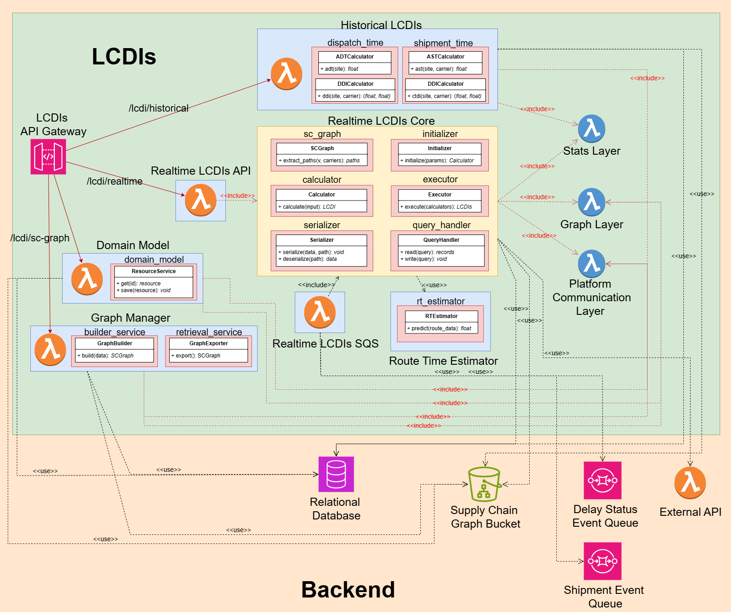
Prototype Architecture
Prototype & RESULTS
Implementation & Deployment
Developed in Python with deployment on AWS:
AWS Lambda Functions & Layers.
Amazon RDS (Relational Database Service).
Amazon S3 (Object Storage).
Amazon API Gateway.
Amazon SQS (Simple Queue Service).
Modularity & Configurability
Dynamic hyperparameter tuning via centralized configuration table.
Modular design enabling independent evolution of individual components.

Slide 35
Evaluation Methodology (1)
Evaluation focused on the system’s ability to accurately predict delivery time windows for orders, leveraging event data reported by carriers throughout the shipment process.
PROTOTYPE & Results
Estimations Time Resolution
Distributions fitted using hourly-resolution data; model evaluated at daily scale using two approaches:
Hourly-based: metrics computed from hourly predictions, then reported by day.
Daily-based: predictions discretized into business days, with metrics directly evaluated at this scale.
Operational Stages
Dispatch Stage: both dispatch time and shipment time must be estimated.
Shipment Stage: dispatch time already known; only shipment time is estimated.
Set splits
Training Set: used to fit the probability distributions.
Test Set: completely unseen during training, used solely for performance evaluation.

Slide 36
Evaluation Methodology (2)
Evaluation focused on the system’s ability to accurately predict delivery time windows for orders, leveraging event data reported by carriers throughout the shipment process.
PROTOTYPE & Results
Evaluation steps
Quantitative evaluation on three metrics:
Sharpness: width of predicted intervals.
Coverage: proportion of observations within the predicted interval.
Interval Score: single measure accounting for both sharpness and coverage.
Sensitivity Analysis: assessing model coverage across varying confidence levels.
Visualization of the evolution of shipment estimates.
Model Variants
Multiple implementations tested for real-time indicators.
Best-performing solution:
Polynomial version of the TFST weighting factor.
Baseline approach for DRT.

Slide 37
Quantitative Evaluation
Prototype & RESULTS
Operational Stage | Sharpness (days) |  | Coverage (%) |  | Interval Score (days)
 | Hourly | Daily | Hourly | Daily | Hourly | Daily
Dispatch | 2.15 | 2.20 | 0.28 | 0.56 | 4.22 | 4.26
Shipment | 1.03 | 1.18 | 0.52 | 0.84 | 1.45 | 1.63
Training Set – 90% Confidence
Operational Stage | Sharpness (days) |  | Coverage (%) |  | Interval Score (days)
 | Hourly | Daily | Hourly | Daily | Hourly | Daily
Dispatch | 2.87 | 3.00 | 0.3 | 0.5 | 7.81 | 7.44
Shipment | 1.30 | 1.55 | 0.63 | 0.86 | 1.99 | 2.20
Test Set – 90% Confidence

Slide 38
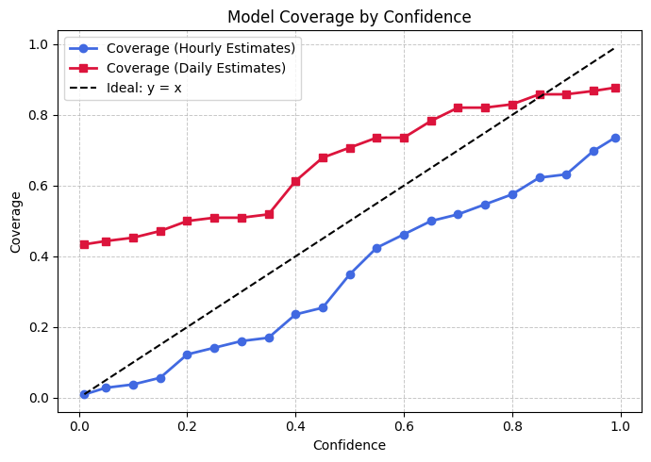
Sensitivity Analysis
Prototype & RESULTS
Evaluation
Coverage assessed on the test set across multiple nominal confidence levels.
Hour-resolution estimates show under-reliability.
Day-resolution estimates show over-reliability up to a nominal confidence of 0.85

Slide 39
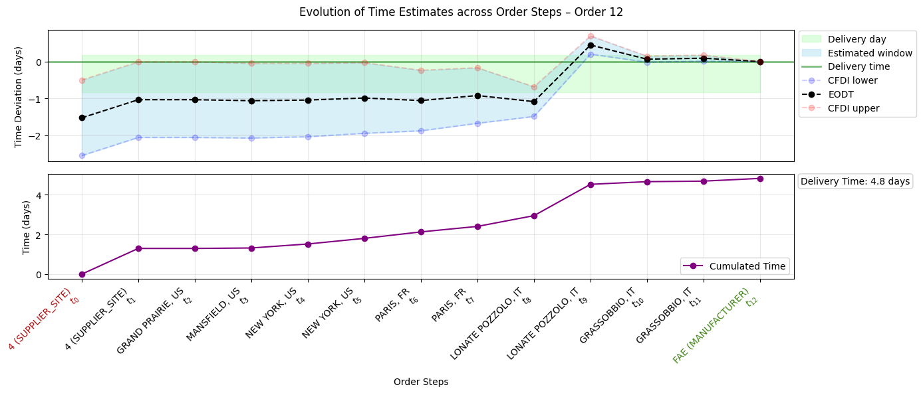
Evolution of Shipment Estimates (1)
Prototype & RESULTS

Slide 40
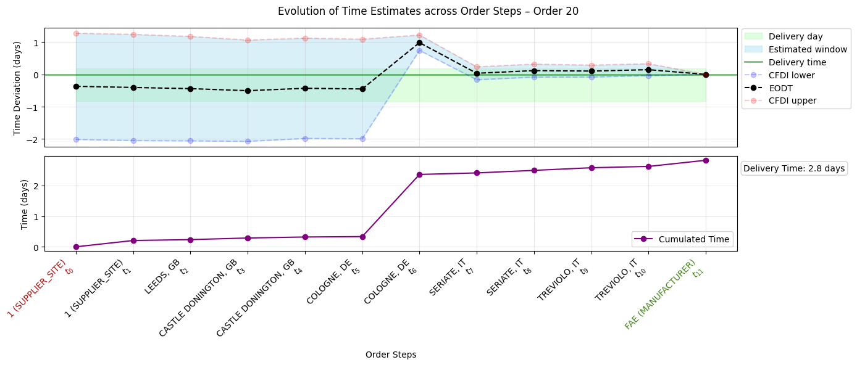
Evolution of Shipment Estimates (2)
Prototype & RESULTS

Slide 41
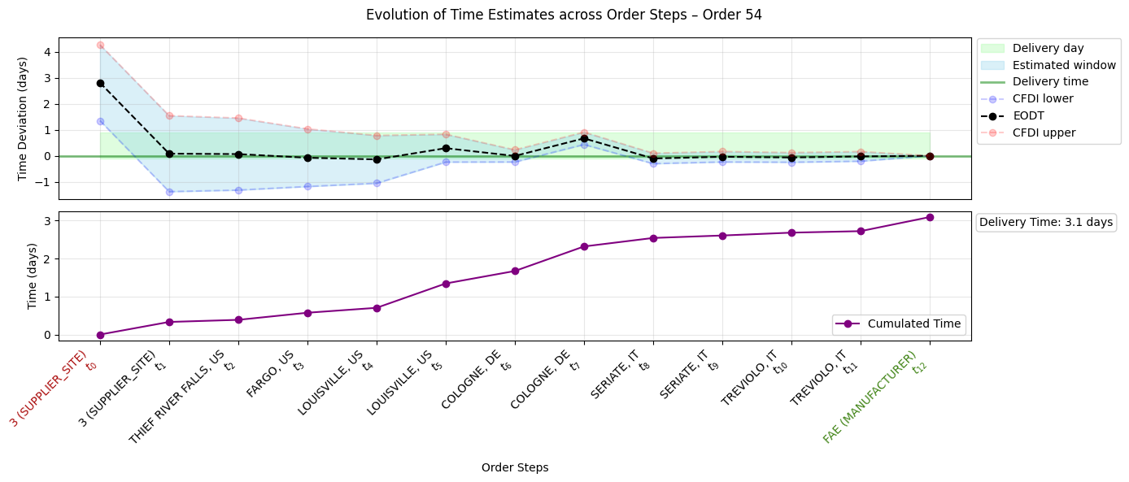
Evolution of Shipment Estimates (3)
Prototype & RESULTS

Slide 42
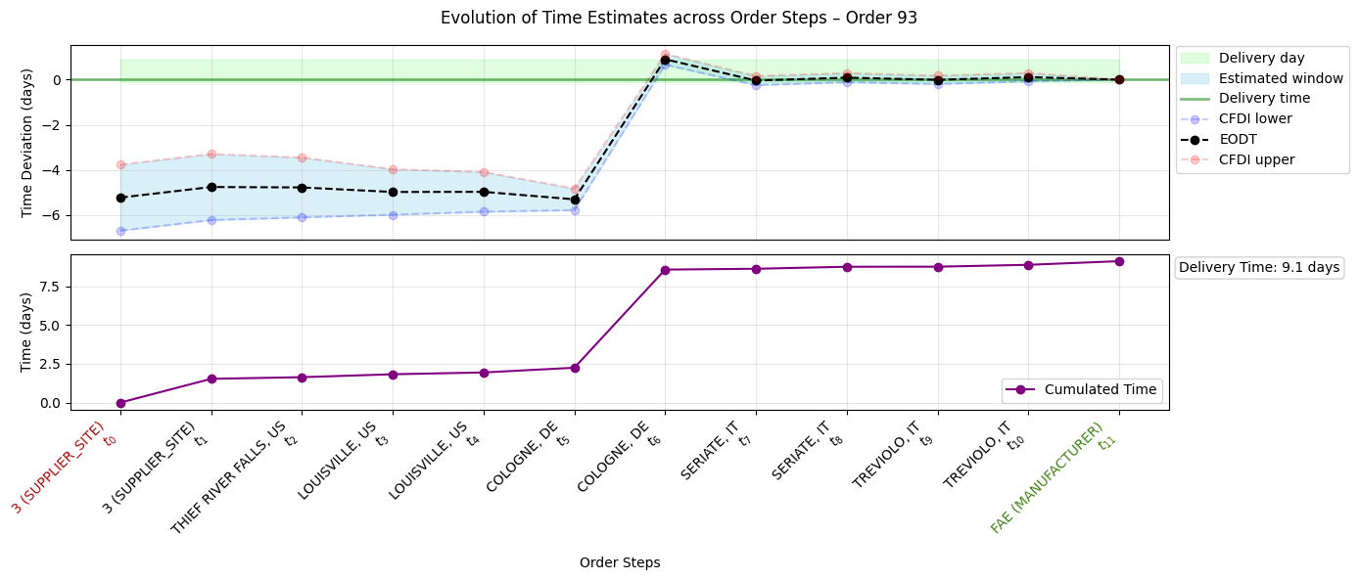
Evolution of Shipment Estimates (4)
Prototype & RESULTS

Slide 43
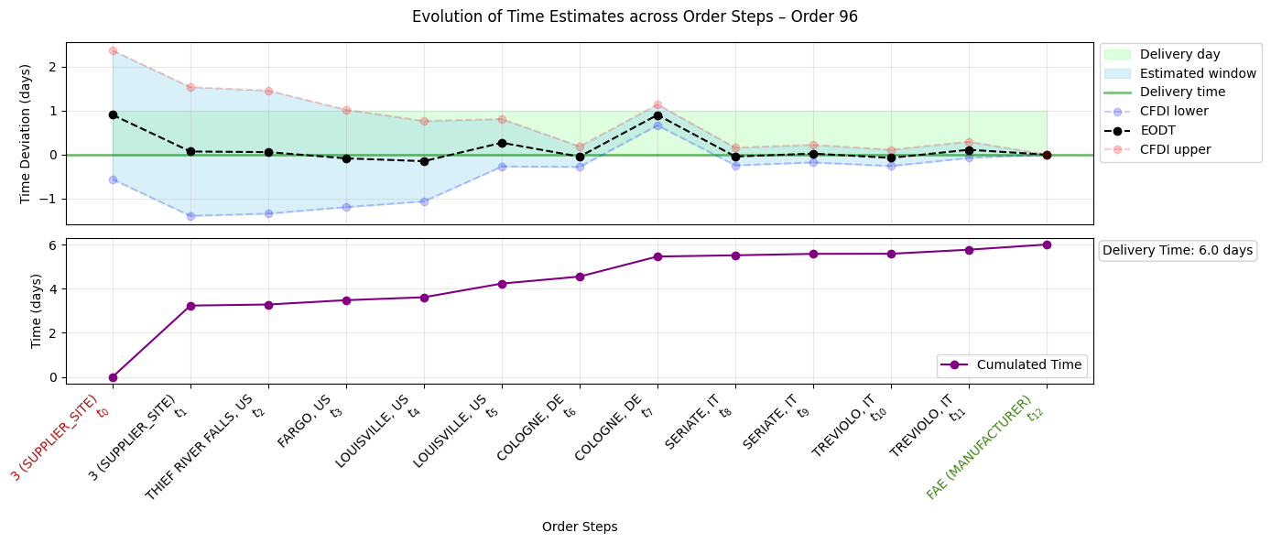
Evolution of Shipment Estimates (5)
Prototype & RESULTS

Slide 44
Conclusion

Slide 45
Key Findings
Overall calibration shows some under-reliability, particularly at higher confidence levels; nevertheless, even with limited data the framework already enables effective disruption detection.
conclusion
Real-Time Delay Detection
The system detects disruptions in real time as shipment events are received, fully meeting the project’s core requirements.
Time Resolution Trade-off
Hourly estimates offer finer resolution but lower reliability; daily estimates are better calibrated for practical use.
Operational Stage
Dispatch stage estimates remain unreliable; shipment stage provides actionable insights as uncertainty decreases, even with the limited amount of data available.

Slide 46
Future Developments
Future development should focus on acquiring more data to improve calibration and support the implantation of more sophisticated, formally defined solutions for specific indicators.
conclusion
Data Expansion
Expand the dataset and refine all data-driven components, such as probability distributions, to improve calibration, enhance indicators, and increase the reliability of predictions.
Refinement of Indicators Implementation
Implement and validate more advanced solutions for specific indicators, in particular DRT (e.g., Bayesian methods, quantile regression).
Multi-Manufacturer Extension
Extend framework to support multiple manufacturers and more complex operational contexts.

Slide 47
References
CONCLUSION
L. R. Ford and D. R. Fulkerson, “Maximal flow through a network,” Canadian Journal of Mathematics, vol. 8, no. 3, pp. 399–404, 1956.
J. R. Norris, Markov Chains. Cambridge University Press, 1998.
G. Grimmett and D. Stirzaker, Probability and Random Processes, 3rd.Oxford University Press, 2001.
A. V. Hill, J. M. Hays, and E. Naveh, “A model for optimal delivery time guarantees,” Journal of service research, vol. 2, no. 3, pp. 254–264, 2000
T. Gneiting and A. E. Raftery, “Strictly proper scoring rules, prediction and estimation,” Journal of the American Statistical Association, vol. 102,no. 477, pp. 359–378, 2007.
Y. Huang, A. Bárdossy, and K. Zhang, “Sensitivity of hydrological models to temporal and spatial resolutions of rainfall data,” Hydrology and Earth System Sciences, vol. 23, no. 6, pp. 2647–2663, 2019.

